Slide 1
Biweekly Meeting for RL Based Truck&Trailer Project
March 3rd 2023

Slide 2
Recently Updates
Conduct Experiments on Truck Trailer model in pybullet
Make the deviation part of the reward structure into function form
Prepare for the paper

Slide 3
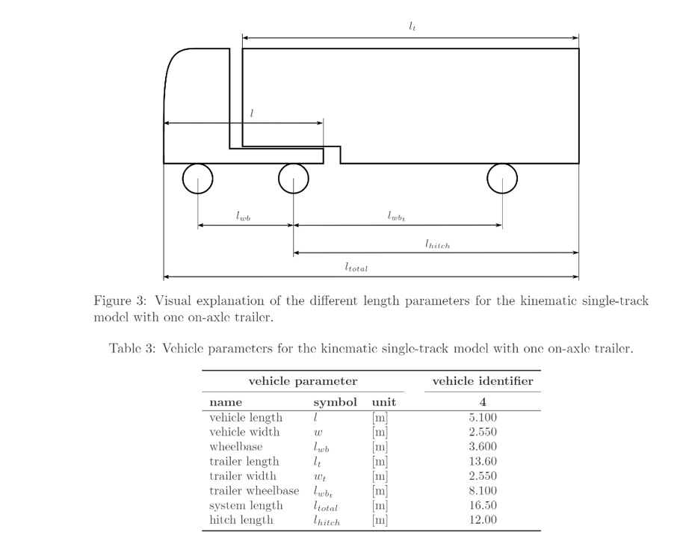
Truck Trailer model

Slide 4
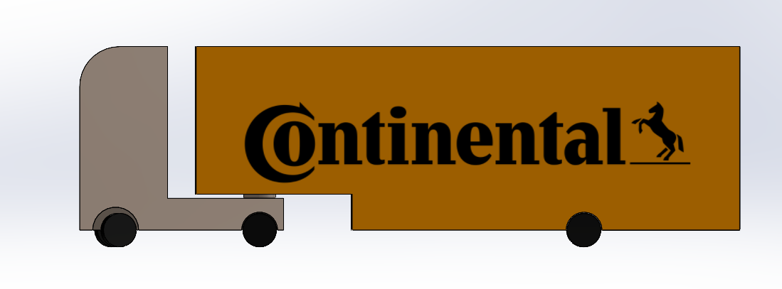
Truck Trailer manipulation in pybullet
Truck_Trailer_demo.mp4 (sharepoint.com)

Slide 5
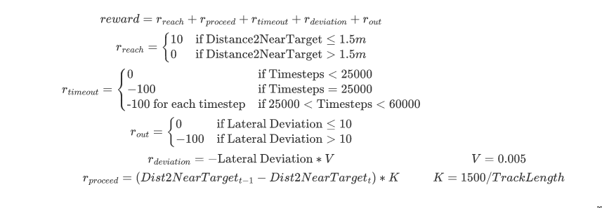
Reward function revision

Slide 6
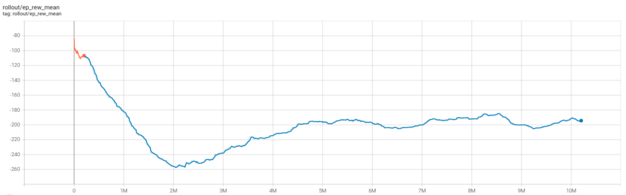
Training Results of Changed Deviation Part
Reward

Slide 7
Plans for next two week
Integrate truck trailer model into gym framework and conduct testing
Design reward function for new environment
Fine tuning the hyper parameter to adjust the weights of deviational part in reward structure
Finish the abstract and introduction part of thesis

